Slide 1
Radioactivity

Slide 2
Atomic Symbols
Atoms are represented by using atomic symbols like the one below.
The mass number (A), sometimes called the atomic mass, is the total number of nucleons (protons and neutrons).
The atomic number (Z) is the number of protons in the nucleus.
The number of neutrons (N) is given by A – Z.
Mass number A
$${}_{8}^{16}O$$
Element symbol
Atomic number Z

Slide 3
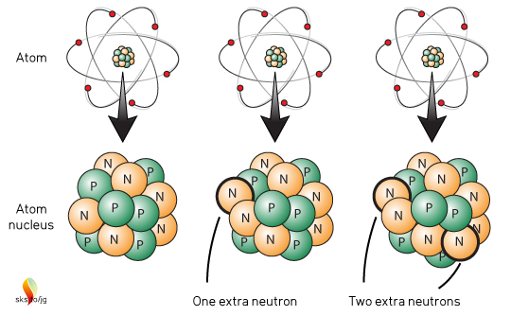
Isotopes
Atoms of the same element all have the same number of protons, but the number of neutrons can be different.
Atoms of the same element with different numbers of neutrons are called isotopes.
For example, carbon isotopes all have 6 protons, but they have different numbers of neutrons (6, 7, and 8).

Slide 4
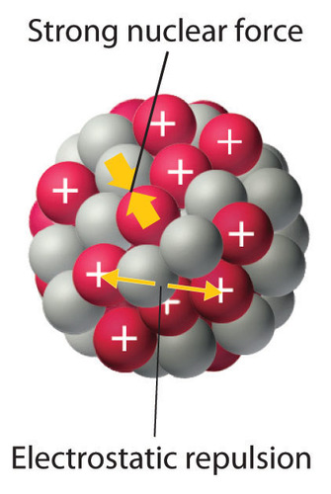
Forces in the Nucleus
Within a nucleus, protons exert electrostatic forces of repulsion on each other.
These forces can act over large distances.
The force of repulsion between the protons can tear a nucleus apart.
However, there is another force: the strong nuclear force. It is a force of attraction that holds the nucleus together.
The strong nuclear force exists between every nucleon, regardless of charge.
This force is much stronger than the electrostatic force, but it only acts over very short distances.

Slide 5
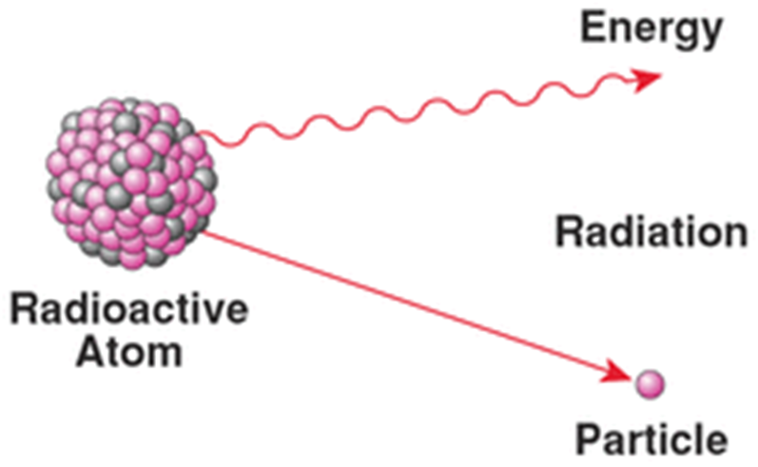
Transmutation
Most of the atoms that make up the world around us are stable: their nuclei haven’t changed since they were formed, and they will stay that way in the future.
However, there are also naturally occurring isotopes that are unstable: their nuclei are likely to change in the future.
An unstable nucleus may become stable by changing into a different element, releasing a particle as it does so. This process is called spontaneous transmutation.
Unstable nuclei that emit particles and/or radiation are said to be radioactive.

Slide 6
Stability of Nuclei
In a stable nucleus, a delicate balance exists between the repulsive electrostatic force and the attractive strong nuclear force.
One of the heaviest stable isotopes is bismuth-209, with 83 protons and 126 neutrons.
In bismuth-211, the two extra neutrons upset the balance between the forces.
Thus bismuth-211 is unstable and decays, ejecting two protons and four neutrons from its nucleus in an attempt to become stable.
Notes:
Technically bismuth-209 was found to be weakly radioactive in 2003, but its half-life is more than a billion times the estimated age of the universe, so whatever

Slide 7
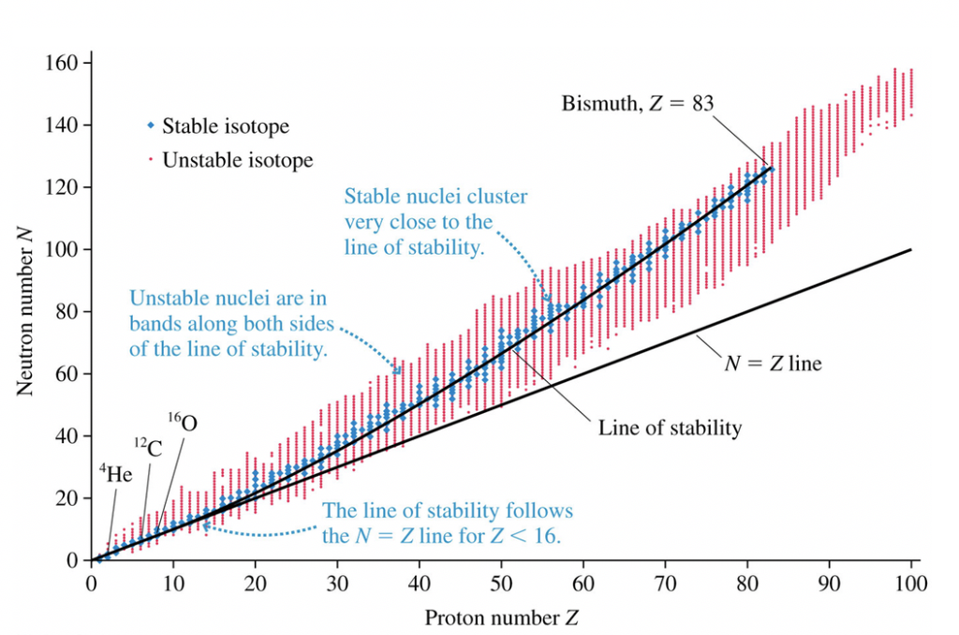
Stability of Nuclei
When N and Z are graphed against each other, a line of stability can be observed, along which the stable nuclei are clustered. Isotopes away from this line are usually unstable (if they exist at all).
For nuclei with atomic numbers up to 15, the neutron to proton ratio in stable nuclei is close to 1.
As nuclei become bigger, this ratio increases.
Zirconium-90 (Z = 40) has a ratio of 1.25, and for mercury-200 (Z = 80) it is 1.5.

Slide 8
Stability of Nuclei
As the number of protons in the nucleus increases, more neutrons are needed to keep it stable.
These neutrons ‘dilute’ the repulsive forces between the protons by increasing the average distance between them.
Elements with more protons than bismuth (Z = 83) cannot be stabilised: they are always radioactive.

Slide 9
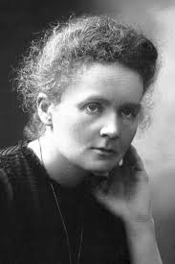
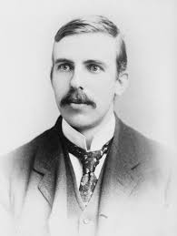
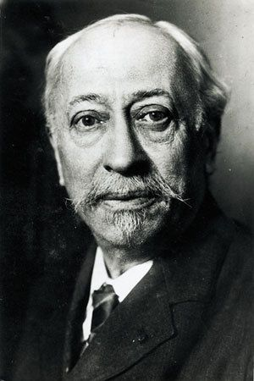
Radioactivity
Around the beginning of twentieth century scientists such as Marie Curie, Ernest Rutherford and Paul Villard were investigating two newly discovered elements: polonium and radium.
They discovered three types of emissions from these substances.
They named them alpha, beta and gamma radiation.

Slide 10
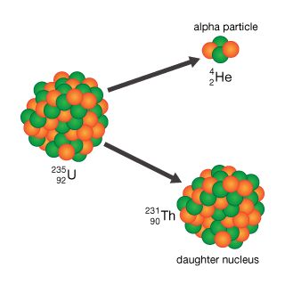
Alpha (α) decay
When a heavy unstable nucleus undergoes radioactive decay, it may eject an alpha particle.
This is a positively charged particle that consists of two protons and two neutrons, with no orbiting electrons.
An alpha particle is identical to a helium nucleus and is sometimes written as ${}_{2}^{4}{He}$.

Slide 11
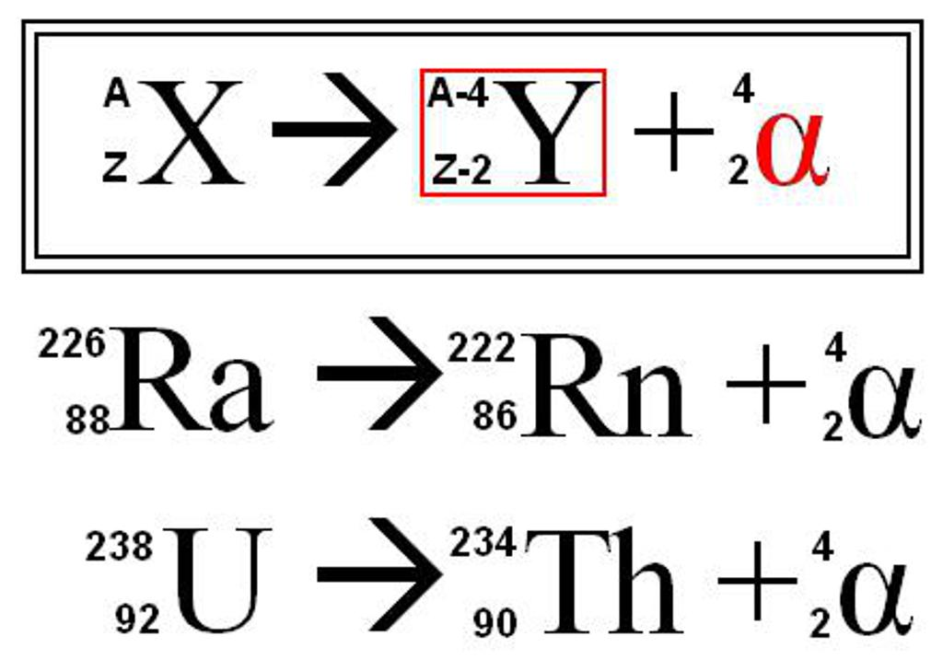
Alpha (α) decay
The parent nucleus has spontaneously emitted an alpha particle and has undergone transmutation to form the daughter nucleus.
In nuclear transmutations electric charge is conserved.
The sums of atomic numbers on both sides of the equations should be equal.

Slide 12
Beta (β) decay
Beta decay happens in isotopes that have too many protons or neutrons.
There are two types of beta decay: ${\text{β}}^{+}$ and ${\text{β}}^{_}$.

Slide 13
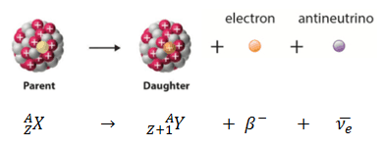
Beta minus (${\text{β}}^{_}$) decay
Beta minus decay happens when an unstable atom has a relatively large number of neutrons. It emits an electron (beta particle) from the nucleus to become stable.
In beta minus decay a neutron splits into a proton, an electron and an antineutrino.
Beta minus decay is more common than beta plus decay and is sometimes simply referred to as beta decay.
$${ 14 \atop 6}\text{C} →{ 14 \atop 7}\text{N}+ {}_{−1}^{0}β+\overline{ν}$$
Notes:
ν is the Greek letter nu.

Slide 14
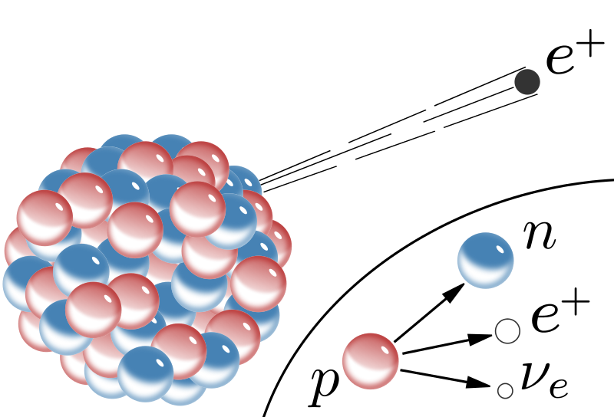
Beta plus (${\text{β}}^{+}$) decay
Beta plus decay (positron emission) happens when an unstable atom has too many protons.
In ${\text{β}}^{+}$ decay a proton in the nucleus decays to a neutron, positron and a neutrino.
The neutron stays in the nucleus while the other two are emitted.
A positron is a positive particle like an ordinary electron in mass but of opposite charge.
$${ 11 \atop 6}\text{C} →{ 11 \atop 5}\text{B}+ {}_{+1}^{0}β+ν$$

Slide 15
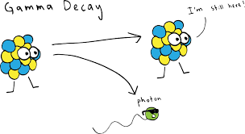
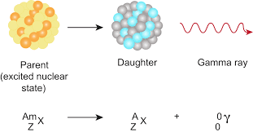
Gamma ($γ$) decay
Gamma decay, in which some unstable atomic nuclei dissipate excess energy by spontaneously emitting gamma rays.
Gamma rays are photons, or packets of electromagnetic energy, of extremely short wavelength.
$${ 137 \atop 56}\text{Ba} →{ 137 \atop 56}\text{Ba}+γ$$

Slide 16
Writing Nuclear Equations

Slide 17
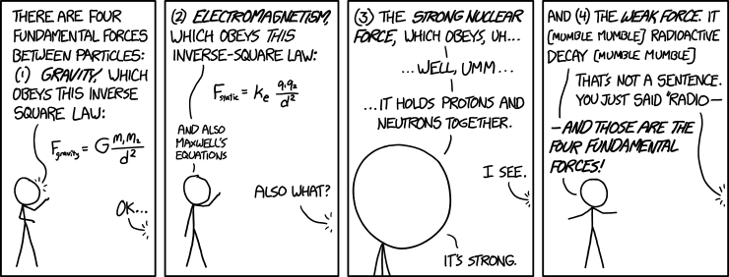
"Of these four forces, there's one we don't really understand." "Is it the weak force or the strong--" "It's gravity."
Notes:
https://xkcd.com/1489/

